Slide 1
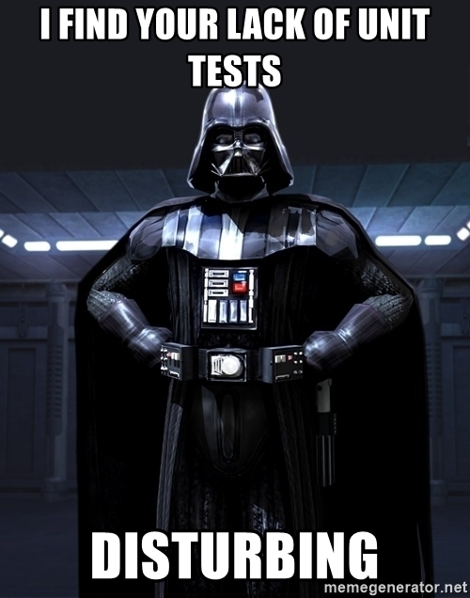
Unit testing
How to be a unit test ninja
Jackie Norris
Nov 2020

Slide 2
What is a unit test?
A unit test is a test that validates a single unit of software performs as expected.
It verifies the behavior independently from other unit.
It mocks out external party so that it is purely testing that one unit of work.
It doesn’t hit datasources like MongoDB or SQL

Slide 3
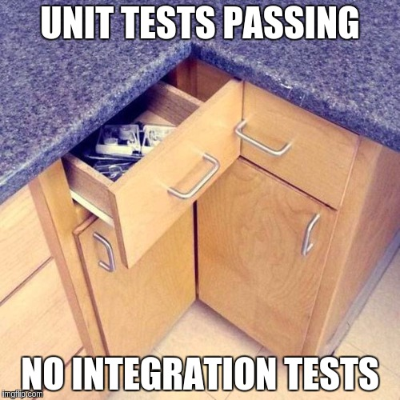
What is an integration tests?
Integration testing is testing multiple units together to confirm that the whole pipe of work performs as expected.
Integration testing is testing the interaction between units.
This can hit databases, external apis etc.

Slide 4
Why unit tests are awesome
Code is more reliable
Given certain inputs the output/behavior of the unit is constant.
Code is less coupled
Since unit test should be testing a single unit it makes it easier and better if the code is written with de-coupling in mind.
Code is re-usable
Since a work should be broken into as small units as possible. It means that a lot of the base code is now in places that can be re-used by multiple components
Enforces good coding practices and principles
Single responsibility principles
Inverse of Control (IoC)

Slide 5
Why unit tests are awesome
Increases maintainability
If code is covered thoroughly by tests. Then changes can be made with confidence as it is easy to understand what the code was expected to do and what impact your change will have on the system.
Saves on costs
Fixing a bug while in development is a lot cheaper than fixing a production bug.
Development is faster
Running VS on ever change takes time. Stopping and starting up front-ends to test takes time.
A unit test should be quick and easy to run.
Although more time is used to create the test at the beginning it overall ends with something that is easier to run and test.

Slide 6
What makes a good unit test?
Easy to write
Easy to maintain
Easy to understand
Reliable - No flaky tests
Fast
Unit not integration test
Testing only one outcome per test
Notes:
What is been tested and what is the expected outcome

Slide 7
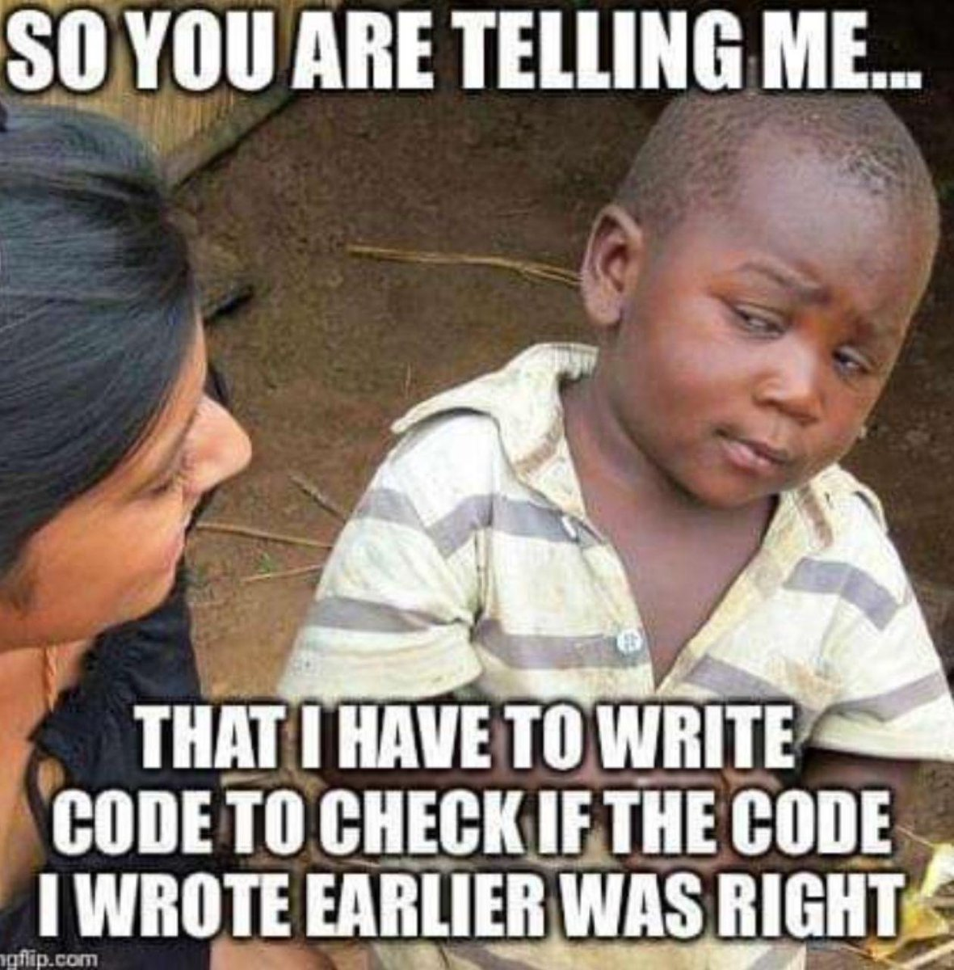

Slide 8
How to write tests
Decide on a naming convention for tests that makes it clear what is been tested and what the outcome is
When_<Action>_With_<Usecase>_Expect_<Outcome>
for example When_GetAllGatewayDevices_WithCache_Expect_PopulatedList
Use constants to make the test easier to follow
Have a single place initializing the class you are testing
This helps maintainability since if a new parameter is added to the ctor you only have to update the code in one place
Keep AAA in mind
Arrange
Act
Assert
Notes:
What is been tested and what is the expected outcome

Slide 9
How to write tests
Start with writing the tests (TDD)
This will help structure the code in a clean testable way
Avoid
Static properties that hold state
True singleton
Methods not following Single Responsibility
If you are struggling step back and look at the architecture design
There may be an additional level of abstraction needed to make the code cleaner and help make the writing the tests easier
Notes:
What is been tested and what is the expected outcome

Slide 10
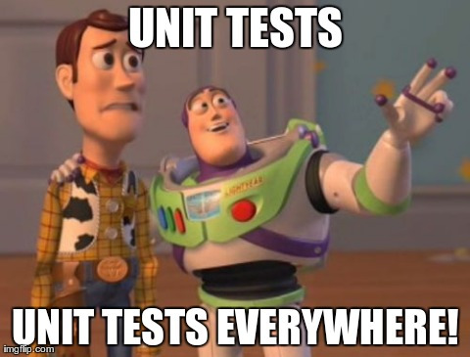

Slide 11
NUnit
Never make a test async void
Test
Assert values are as expected
Assert exceptions thrown
TestCase
Allows parameterized tests
TestCaseSource
Allows a list of test parameter

Slide 12
Moq
Setup
Setup methods
Setup properties
Change returns based on incoming parameters
Throw Exceptions
Verify
Confirm mocked out classes were called with the correct parameters
VerifyNoOtherCalls

Slide 13
Builder Pattern
Structured way to allows code to be re-used to create base data
AutoFixture
Allows creation of test data

Slide 14


